Slide 1
Unit-8:security and ethical challenges.
computer virus and threats
protection from computer virus
Security and ethical issues in information technology
Computer crime
- Piracy issues and intellectual property.

Slide 2
Computer virus and threats
computer virus is a software program with a ability to make copies of itself, which attacks itself to other application or files. It is one type of malware that inserts its virus code to multiply itself by altering the programs and applications. Computer viruses come in different forms to infect the system in different ways. A computer system virus and threat are lead to loss or corruption of data & files.

Slide 3
Protection from virus we should….
Install anti-virus software and perform regular updates.
Check on the security of the browser & use firewall.
Use secure and complex password.
Use anti-spyware software.
Don’t click on links within emails.
Clean your internet cache and your browsing history.

Slide 4
Security:
Security deals with protecting various resources of a computer system against destruction and unauthorized access. There are two types of security
1.internal security
2.External security
## internal security deals with only three aspect:
user authentication
access control
cryptography

Slide 5
External security:
It deals with the security from the floods, fire, earthquakes ,stolen and so on. To secure ,maintaining backup copies of stored information at places from original information.

Slide 6
Security and ethical issues in information technology
The security and ethical challenges of IT refer to the difficulties that organizations face in managing increasingly complex information and communication technologies. The term embraces the management of systems, policies and procedures designed to protect organizations, their employees, customers and other stakeholders from malicious external threats, and from internal acts of noncompliance with IT policies. The concept has important implications for growing IT areas such as big data, social media, and bring your own device .

Slide 7
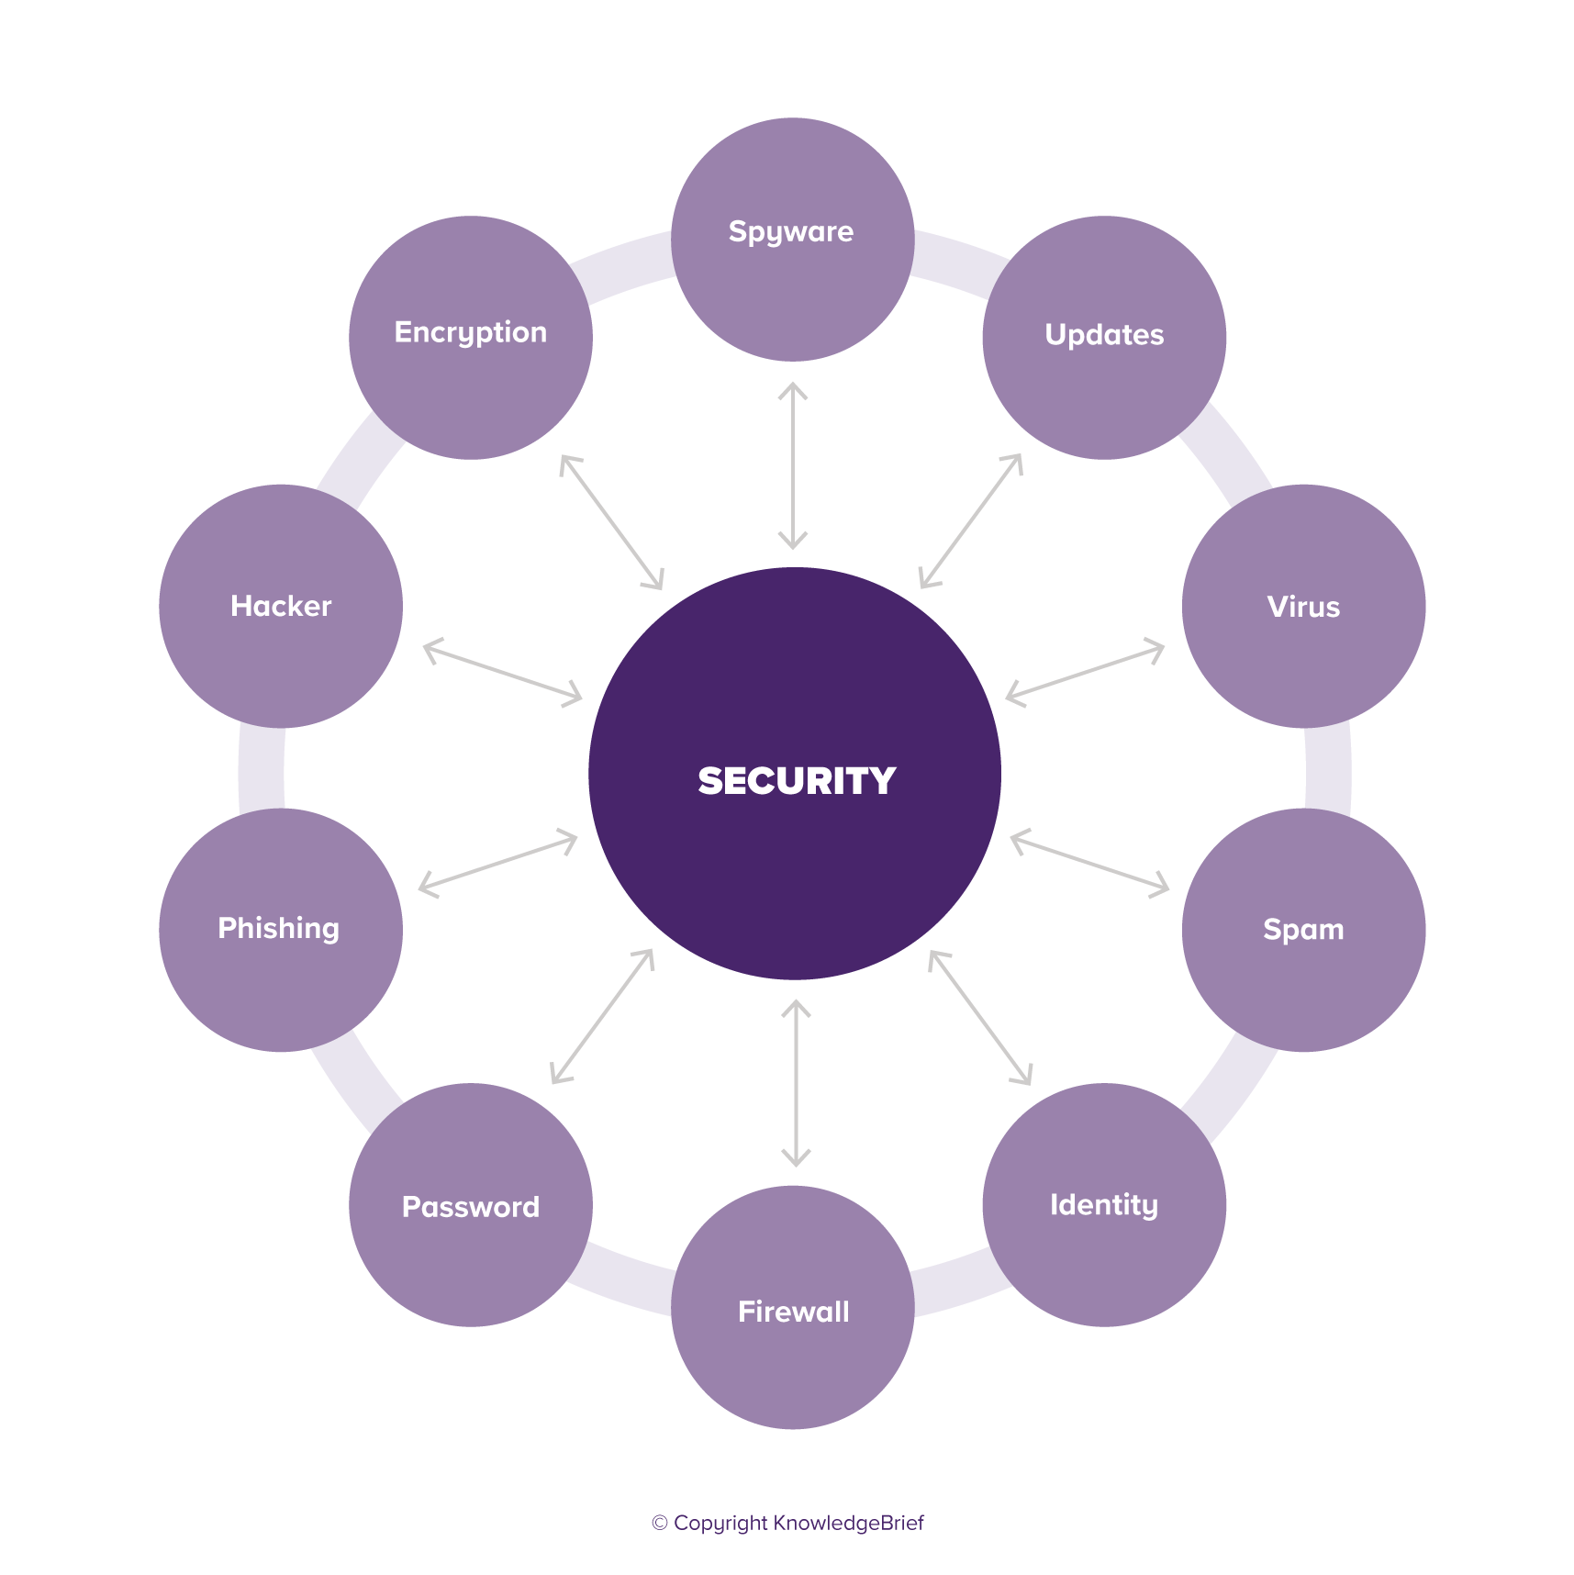
Cont..

Slide 8
Computer crime:
Computer crime has been defined broadly as a criminal act that has been committed using a computer as the primary tools. computer-oriented crime, is a crime that involves a computer and a network. It is the illegal use of a computer by an unauthorized individual ,either for pleasure such as by a computer hacker or for profit as by a thief. Thus it refers to any crime such as unwanted discloser of data that involves a computer and a computer network.

Slide 9
Piracy issues and intellectual property:
piracy is defined as the copying, stealing, reproducing, transmitting, and selling of the intellectual property (IP) of an individual without his or her express consent and written approval as well as without paying that person the royalties due to him or her. Piracy of intellectual property refers to the unauthorized use, reproduction, and/or distribution of protected material such as computer software, video games, music, or movies. Piracy has become an increasing concern in recent years because of the rise of the Internet and the speed with which copyrighted material can be distributed globally to a large number of people

